Slide 1

SYRACUSE ONLINE HOUSING SERVICES
IST 659: Satyen Amonkar

Slide 2
Project Goals
Major functions of database systems are :
Validate the Tenants, Landlords and Property information.
Map property to the informed location.
Assign safety index to each properties based on the crimes recorded in its vicinity.
Take feedback from tenants that reside in a house.
Take feedback from the Landlords about their previous Tenants.
Assign TScore to tenants based on the Landlords feedback.
Maintain information of the lease document between the Landlord and Tenants for their properties.

Slide 3
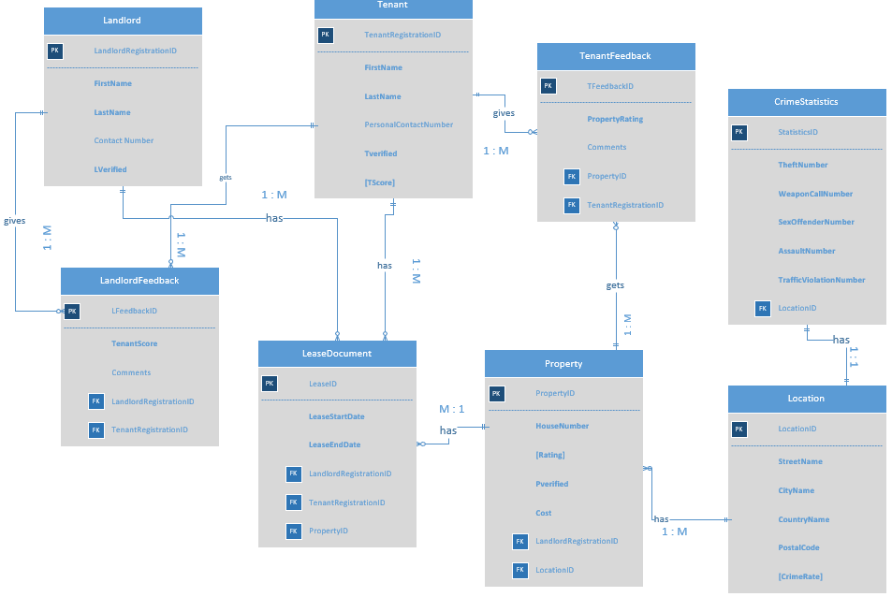
ER Diagram - Visio

Slide 4
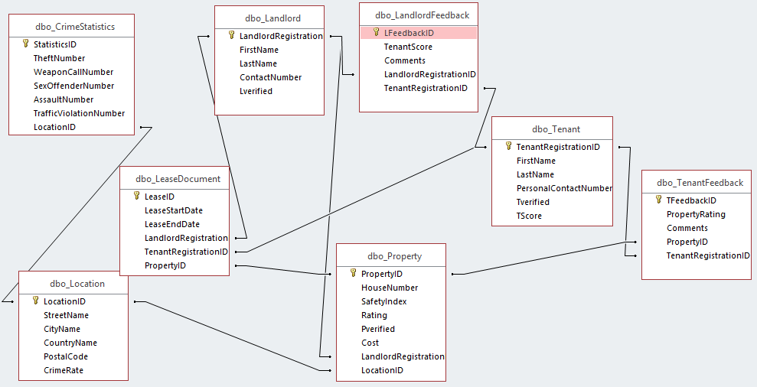
Access Relationship Diagram

Slide 5
Forms
Total Number of Tables: 8
Total Number of Forms: 2
Landlord Feedback Form: Allows you to add and view Landlord Feedback.
Tenant Feedback Form: Allows you to add and view Tenant Feedback.

Slide 6
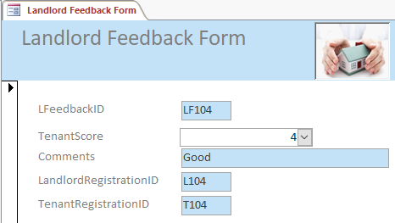
Landlord Feedback Form

Slide 7
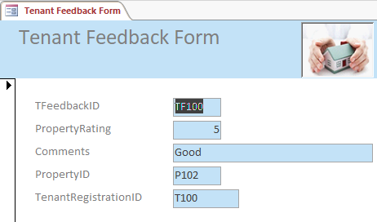
Tenant Feedback Form

Slide 8
Major Data Questions
Which properties in Syracuse have Safety Index greater than 5?
What is the tenure of stay in a property for which the Tenant has given feedback?
How many properties does each landlord own?

Slide 9
Access Query 1
SELECT dbo_Property.HouseNumber, dbo_Property.SafetyIndex, dbo_Property.Rating, dbo_Property.Cost, dbo_TenantFeedback.Comments, dbo_TenantFeedback.PropertyRating
FROM dbo_Property INNER JOIN dbo_TenantFeedback ON dbo_Property.[PropertyID] = dbo_TenantFeedback.[PropertyID]
WHERE dbo_Property.SafetyIndex > 5
ORDER BY dbo_Property.SafetyIndex DESC;

Slide 10
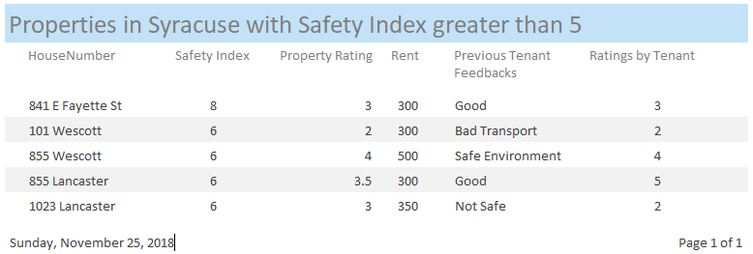
Report 1
Which properties in Syracuse have Safety Index greater than 5?

Slide 11
Access Query 2
SELECT dbo_Landlord.LandlordRegistrationID, dbo_Landlord.FirstName AS dbo_Landlord_FirstName, dbo_LeaseDocument.LeaseStartDate, dbo_LeaseDocument.LeaseEndDate, dbo_Property.HouseNumber, dbo_Property.Cost, dbo_Tenant.TenantRegistrationID, dbo_Tenant.FirstName AS dbo_Tenant_FirstName, dbo_Tenant.TScore
FROM dbo_Tenant INNER JOIN ((dbo_Landlord INNER JOIN dbo_Property ON dbo_Landlord.[LandlordRegistrationID] = dbo_Property.[LandlordRegistrationID]) INNER JOIN dbo_LeaseDocument ON dbo_Landlord.[LandlordRegistrationID] = dbo_LeaseDocument.[LandlordRegistrationID]) ON dbo_Tenant.[TenantRegistrationID] = dbo_LeaseDocument.[TenantRegistrationID]
WHERE dbo_Property.LandlordRegistrationID=[dbo_LeaseDocument].[LandlordRegistrationID] AND
dbo_Property.PropertyID=dbo_LeaseDocument.PropertyID;

Slide 12
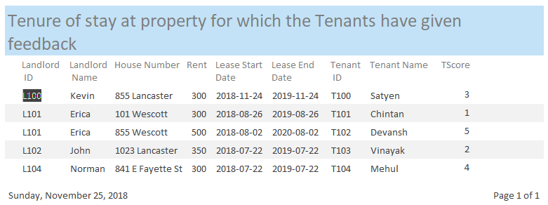
Report 2
What is the tenure of stay in a property for which the Tenant has given feedback?

Slide 13
Access Query 3
SELECT dbo_Landlord.LandlordRegistrationID, dbo_Landlord.FirstName, dbo_Landlord.LastName, COUNT(dbo_Property.PropertyID) AS PropertyCount
FROM dbo_Landlord INNER JOIN dbo_Property ON dbo_Landlord.[LandlordRegistrationID] = dbo_Property.[LandlordRegistrationID]
GROUP BY dbo_Landlord.LandlordRegistrationID, dbo_Landlord.FirstName, dbo_Landlord.LastName;

Slide 14
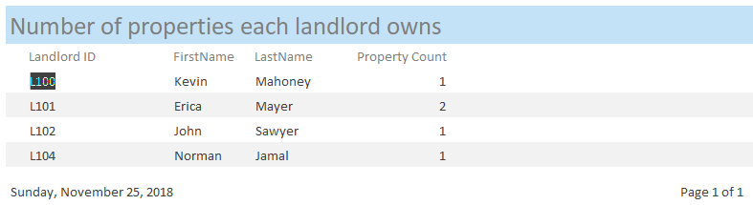
Report 3
How many properties does each landlord own?

Slide 15
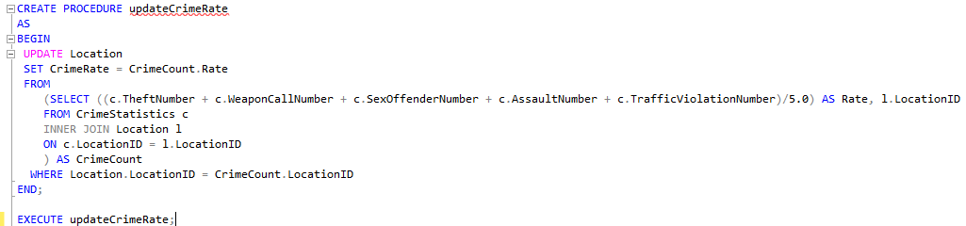
Procedure
This procedure calculates Crime Rate for each location.

Slide 16
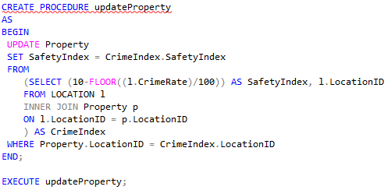
Procedure
This procedure generates Safety Index for each property.

Slide 17
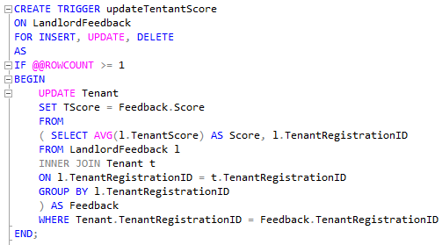
Trigger
This Trigger updates the Tscore of tenants after any Landlord inserts, updates or deletes his feedback.

Slide 18
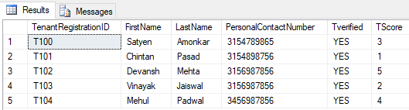
Trigger
Tenant table with TScore before data is updated.
SELECT * FROM Tenant

Slide 19
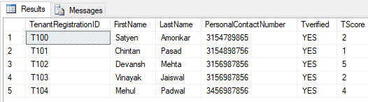
Trigger
Tenant table with TScore after data is updated.
INSERT INTO LandlordFeedback VALUES('LF105',1,'Noisy','L104','T100');

